Slide 1

Building in Bloomfield Hills
March 22, 2023

Slide 2

Introductions
City Administration
Consultants
Dave Hendrickson, City Manager
Amy Burton, Asst. City Manager / City Clerk
Brian Vargason, Building Official
John Rogers, Code Enforcement
Kristen Urbanik, Building Clerk
Jennifer West, Administrative Specialist
Morgan Tisler, Finance / Building Support
Derk Beckerleg
Secrest Wardle – City Attorney
Jill Bahm,Eric Pietsch
Giffels Webster – City Planner
Jamie Burton, Lia Michaels, Remington Koch
Hubbell, Roth & Clark - City Engineer

Slide 3
Goals for Seminar
Why are we here?
Our job is to prepare applicants for an efficient building review and planning and zoning process for a project that is in accordance with the city ordinances.
What systems are in place to support that mission?
Electronic Plan Review
BSA Online
Checklists / Online resources
Pre-construction meetings
Complimentary Planning Office Hours

Slide 4
Process Improvements
Permits Expire after 6 months
Applications expire after 90 days of inactivity
Responsible Escrow Account Management
Why is an escrow required?
Meeting with project team and city staff after 2 failed reviews
Escrow statements and charges

Slide 5
Roles & Responsibilities
City Administration & Consultants
Manage applications and approvals of building projects in the City in accordance with ordinance standards and other policy requirements
Applicant Project Team
Submit complete application packages
Accept guidance from the entire City team; Administration, Consultants, and Boards & Commissions
Boards & Commissions
Apply ordinance standards to project proposal

Slide 6
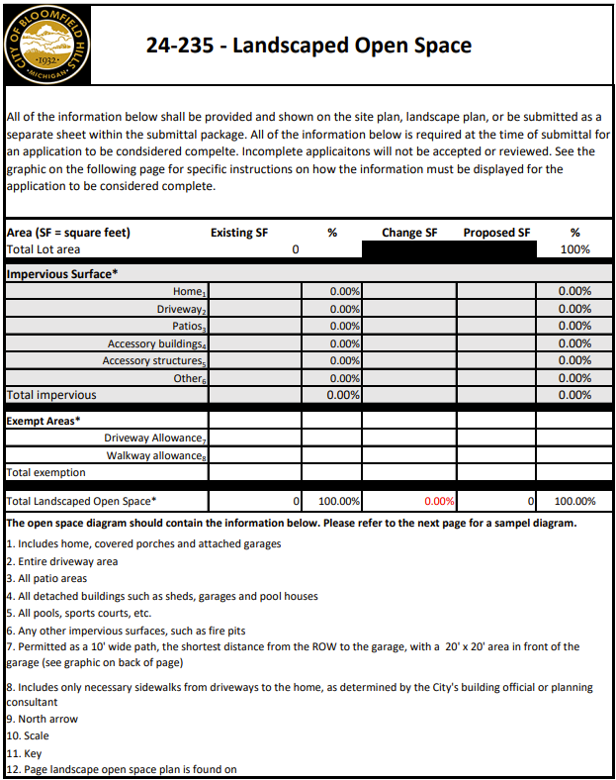
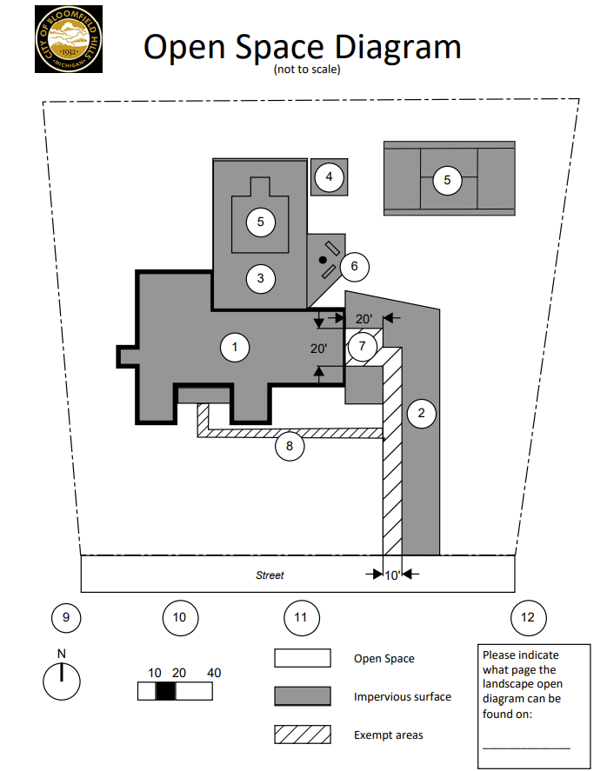
Open Space
www.bloomfieldhillsmi.net/permits-forms

Slide 7
Open Space
All calculations are based on the overall square footage of the lot.
54,321 SF
Each item contains a number & should be shown on the Open Space Diagram.
Subtracting the exemptions from the Total Impervious above will increase the open space.

Slide 8
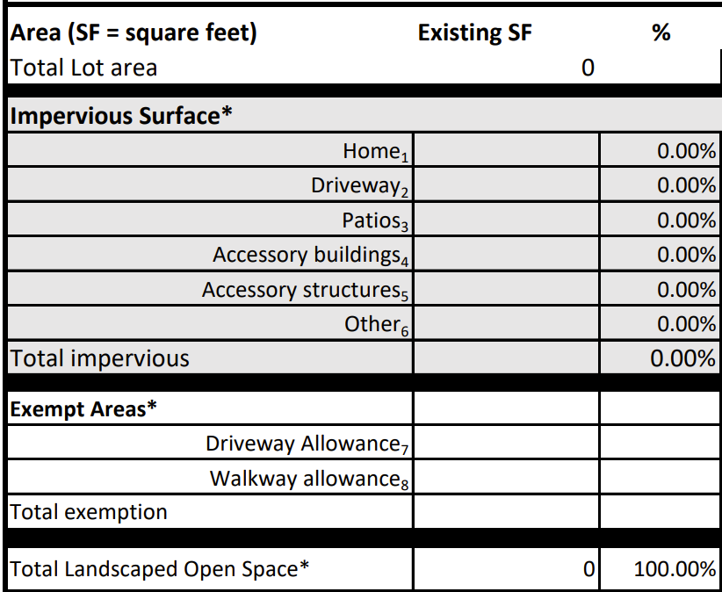
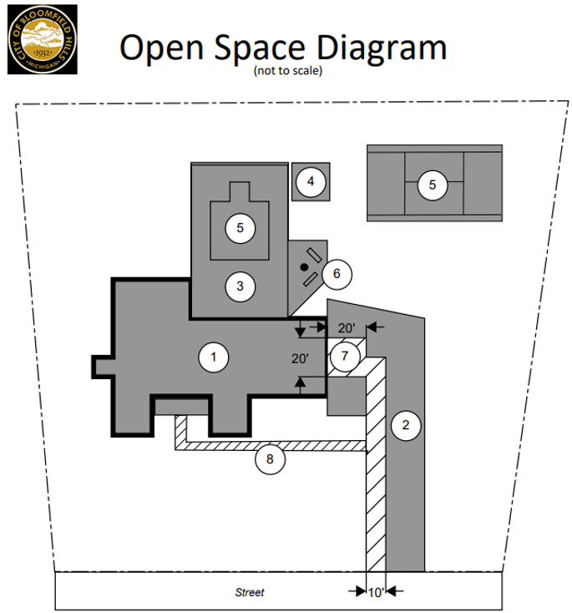
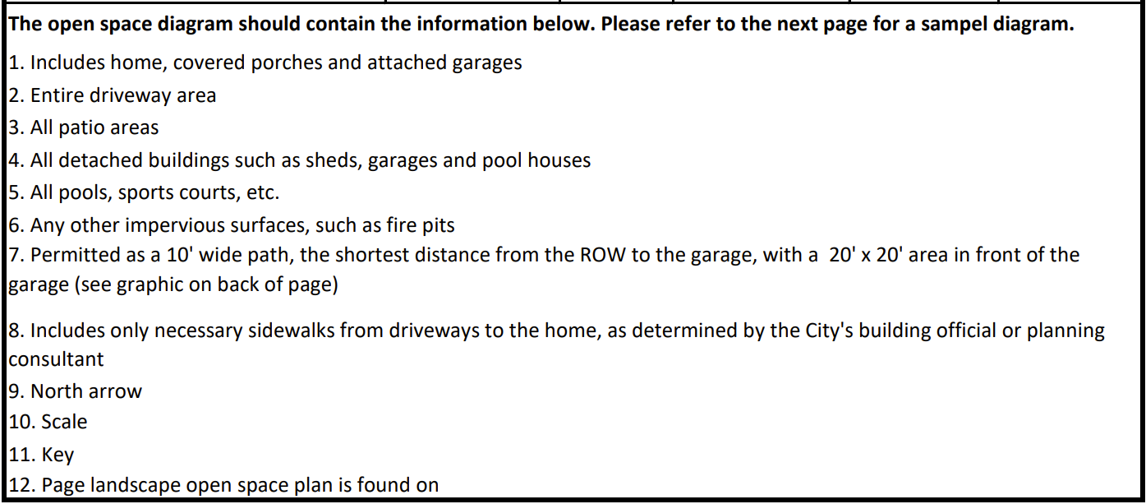
Open Space – Diagram in relation to analysis
(*8 Updated) Impervious surface areas intended solely for pedestrian walkways or plant holders, or structures that have no purpose other than for decoration, such as, but not limited to, sculptures & pieces of art, shall be included as open space, provided that such areas shall not exceed 30% of the total required landscaped open space.

Slide 9
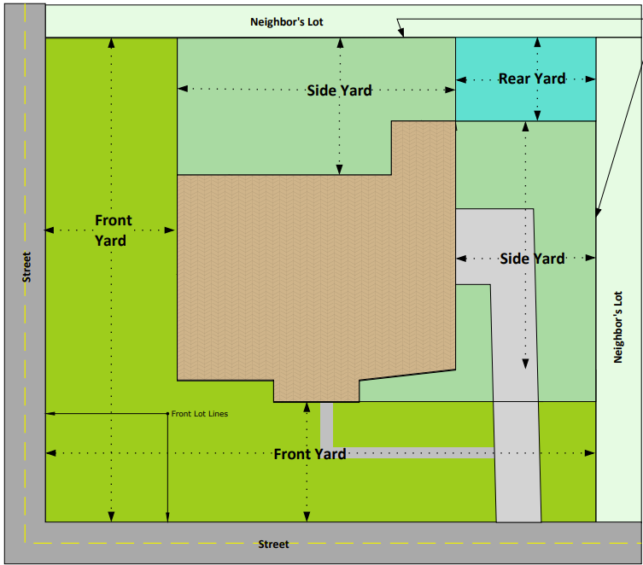
Fences
Front Yard Fence
*Discouraged but reqs. PC approval.
*Open design max ht.: 4-ft.
*Closed design max ht.: 3-ft.
*Req. landscape screening.
Rear Yard Fence
*Permitted up to 6-ft. in height.
*May be solid or open design.
*Higher than 6-ft. requires PC approval & screening.
Fences, walls, & gates are prohibited in a front yard on property that faces the main entrance of the residence on the property.
The planning commission may allow fences, walls, & gates in other front yards that do not face the main entrance of the residence on the property,
or in a side yard subject to the ordinance standards.
Side Yard Fence
*Requires PC approval.
*Open design max ht.: 4-ft.
*Solid design max ht.: 3-ft.
*Req. landscape screening.
Front Yard Fence
*Prohibited in front yard facing the main entrance.
*Reqs. ZBA approval.

Slide 10


Fences – screening (side & front yards)
Not Ready for PC Agenda – NO SCREENING
*Note: Front yard fence segment location*
Ready for PC Agenda – SCREENING PROVIDED
*Note: Front yard fence segment shifted to side yard*
PR. FENCE

Slide 11
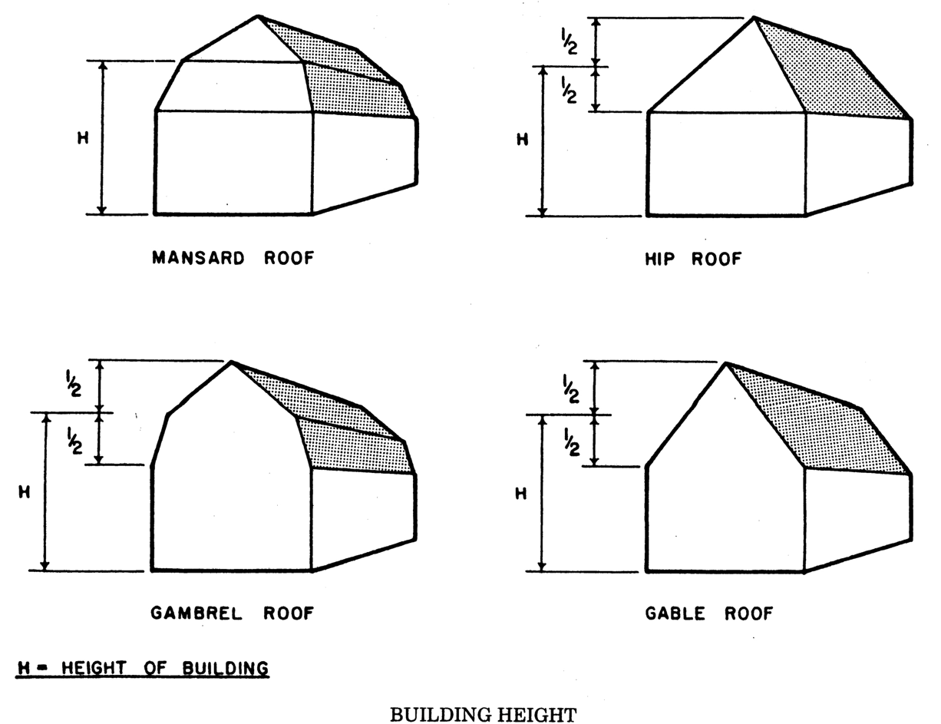
Building Height
Building height shall mean the vertical distance measured from grade to the highest point of the roof surface for flat roofs; to the deck line of
Mansard roofs;
and to the average height between eaves and ridge for
Gable
Hip
Gambrel roofs.

Slide 12
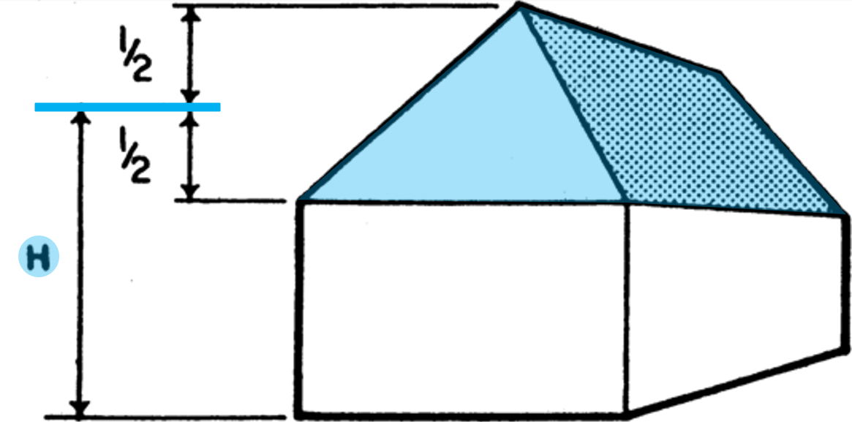
Building Height
Grade shall mean a ground elevation established for the purpose of regulating the number of stories and the height of buildings.
The building grade shall be the level of the ground adjacent to the walls of the building if the finished grade is level.
If the ground is not entirely level, the grade shall be determined by computing the average elevation of the ground at the perimeter of the building.
Example:
Building Height is less than 30’ (27’).
34’
7’
27’
7’
20’
10’
0’
F L A T G R A D E

Slide 13
Building Height
Grade shall mean a ground elevation established for the purpose of regulating the number of stories and the height of buildings.
The building grade shall be the level of the ground adjacent to the walls of the building if the finished grade is level.
If the ground is not entirely level, the grade shall be determined by computing the average elevation of the ground at the perimeter of the building.
Example:
Building Height is greater than 30’ (31’).
38’
31’
24’
14’
Existing Grade
4’
Average Grade
4’
Average Grade
Existing Grade
S L O P E D G R A D E

Slide 14
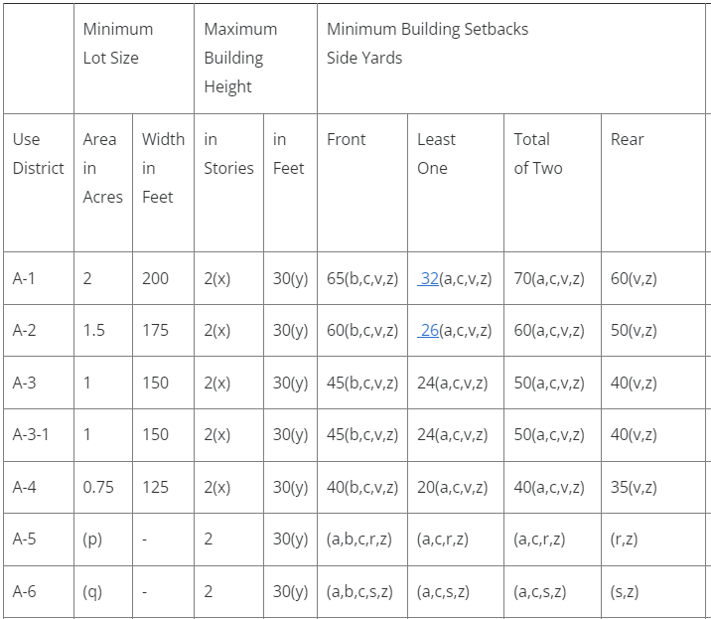
Building Height
24-196 Schedule of Regulations
(y) For the purposes of determining building height, when a new established grade is 2 or more ft. higher than the existing natural ground grade, the measurement shall be taken from the existing natural ground grade (fills).
When a new established grade is lower than the existing natural ground grade, the measurement shall be taken from the new established grade (cuts).

Slide 15
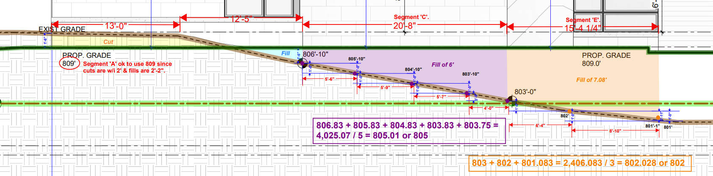
Building Height
GRADING FILLS
(y) For the purposes of determining bldg. hght., when a new established grade is 2 or more ft. higher than the existing natural ground grade, the measurement shall be taken from the existing natural ground grade.
GRADING CUTS
(y) When a new established grade is lower than the existing natural ground grade, the measurement shall be taken from the new established grade.

Slide 16
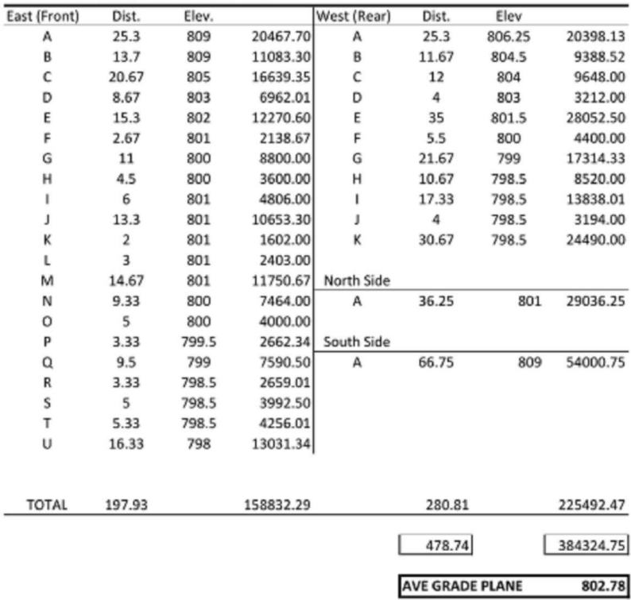


Building Height
Avg. Gd. 802.78
Calculation of avg. grade:
Multiplies distance by elevation.
Sum of each segment.
Divides total value by the total distance.
Result is the average grade.
Total distance equals the perimeter of the building.

Slide 17
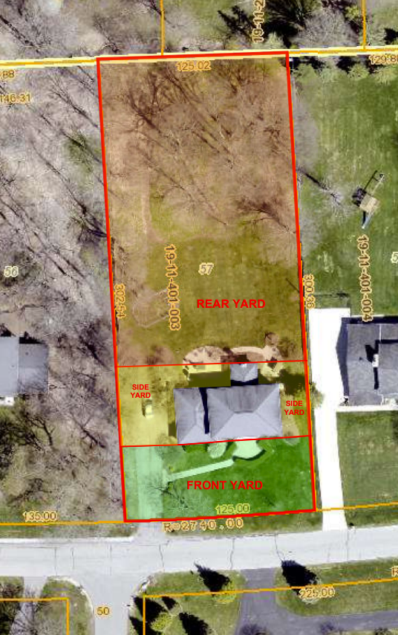
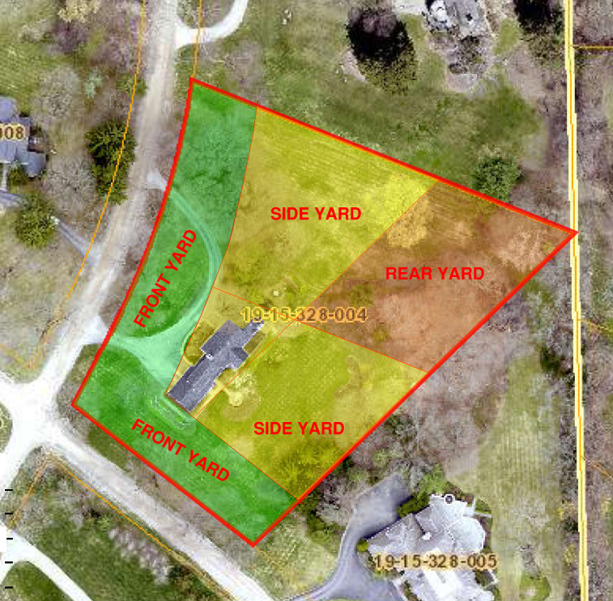
Yard Determinations

Slide 18
Yard Determinations
Yards will determine if a project requires PC or ZBA approval.
For example, a proposed pool and pool fence in the “back yard” of a property (behind the house), may actually be determined to be the side yard, as defined by the ordinance.
Pr. Pool
Pr. Fence

Slide 19
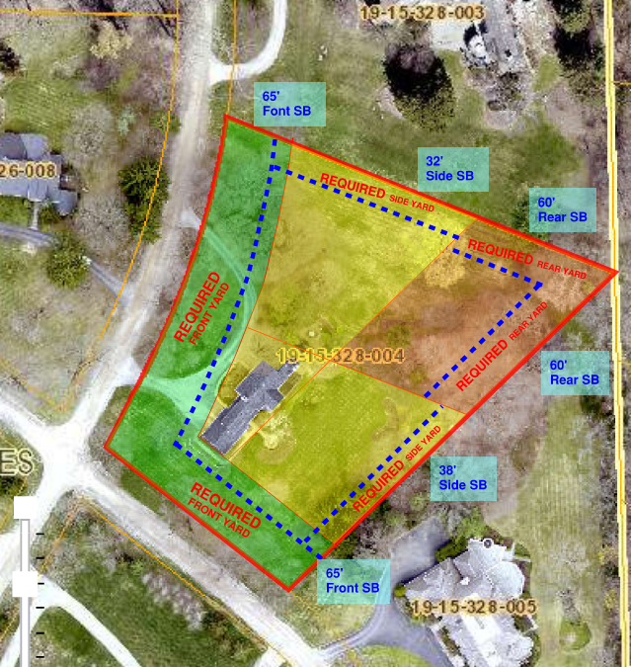
Yard Determinations
Required Yards
Once the yards are determined, the setbacks can be dimensioned & drawn.
The area between each lot line and the setback is considered the required yard.
Pr. Pool
Pr. Fence

Slide 20
Yard Determinations
Required Yards
Once the yards are determined, the setbacks can be dimensioned & drawn.
The area between each lot line and the setback is considered the required yard.
Accessory structures, in this example, the pool, are not permitted within the required side yard. This pool complies but requires PC approval for a side yard location.
Make Note:
Many parcels in Bloomfield Hills are not standard rectangles & have uniquely shaped yards.
The placement of new homes on vacant parcels will establish the layout of the yards. The minimum setbacks of the ordinance must be adhered to.
Side yard accessory structures/buildings require landscape screening.
Pr. Pool
Pr. Fence

Slide 21
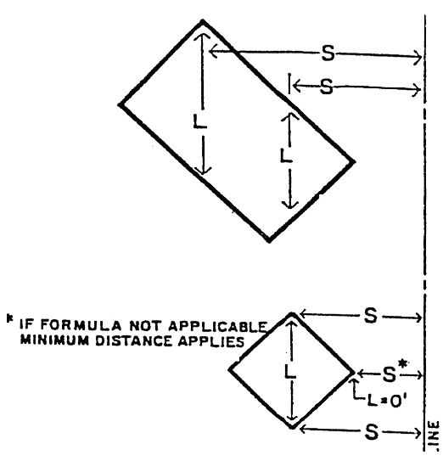
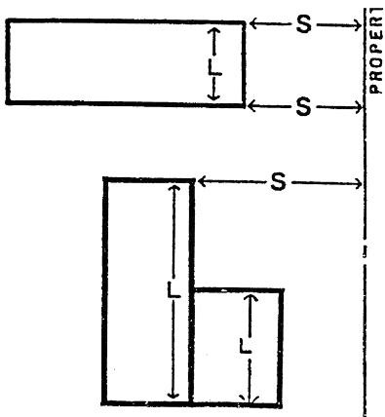

Algebraic Formula – aka “Calculated Setback”
24-196(v)
The minimum setbacks indicated shall apply to main buildings unless exceeded by the distance required by the formula L + 2H / 2, defined as follows:
S – is the required setback.
L – is the total length of a line when viewed directly from above, which is parallel to the lot line & intersects any part of the bldg.
For purposes of measuring “L”, if the depth of the courtyard is greater than its width, the width of the courtyard shall be included in the measurement of “L”.
H – is the height as defined in section 24-3 of the building face adjacent to the lot line.
D – is a divisor (always “2” in the residential districts).
PROPERTY LINE

Slide 22
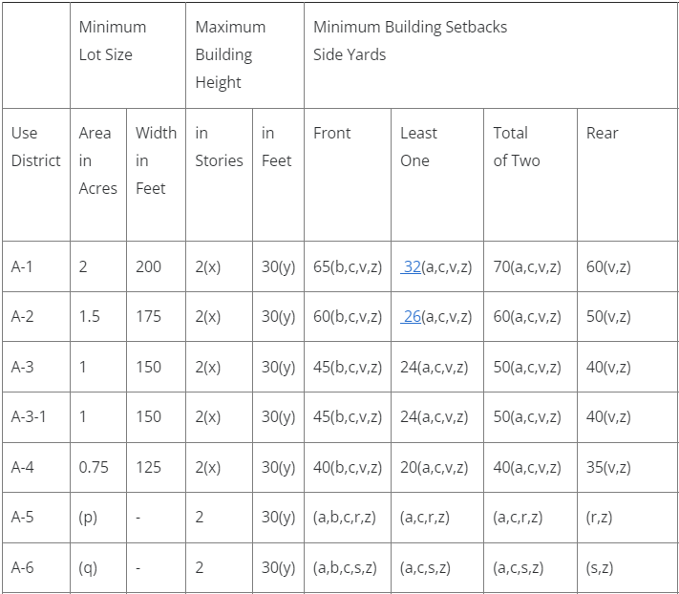
Algebraic Formula – aka “Calculated Setback”
24-196(v)
The minimum setbacks indicated shall apply to main buildings unless exceeded by the distance required by the formula L + 2H / 2.
Note: unless attached to a main building, accessory buildings or structures do not require calculating the setbacks of the algebraic formula.
Note: the A-5 & A-6 Residential Districts are not subject to calculating the setbacks of the algebraic formula.

Slide 23
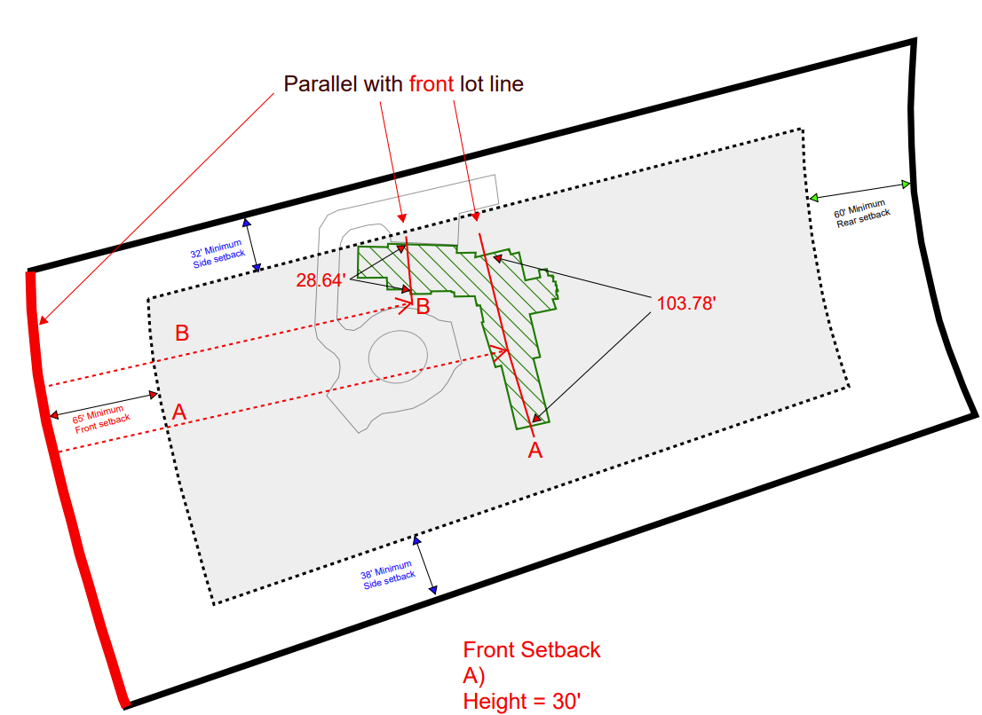
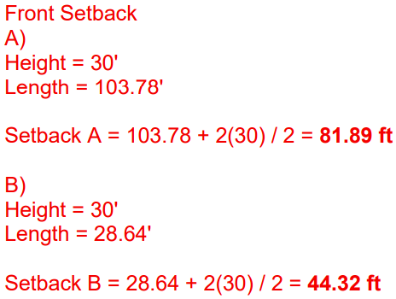
Algebraic Formula – aka “Calculated Setback”
If greater than 44.32’ – complies.
Applicant to dimension setback from PL to Line A:
If greater than 81.89’ – complies.
S T R E E T
*Note: these lines are cross-sections of the home, and not just exterior walls

Slide 24
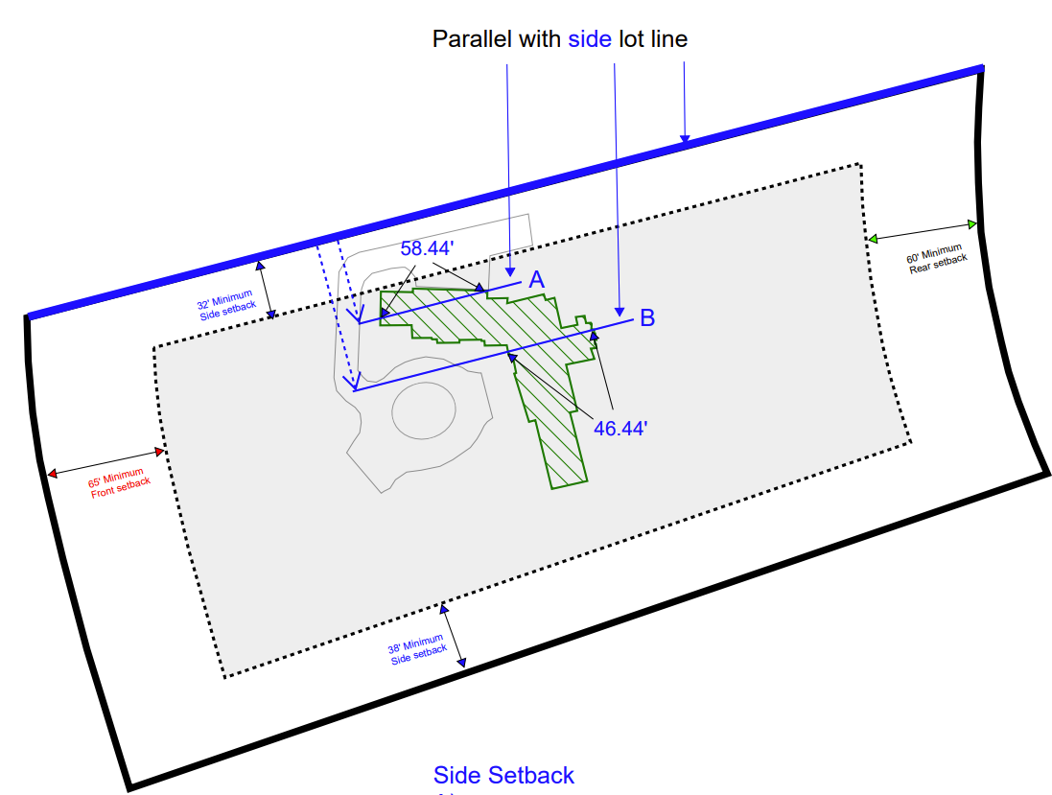
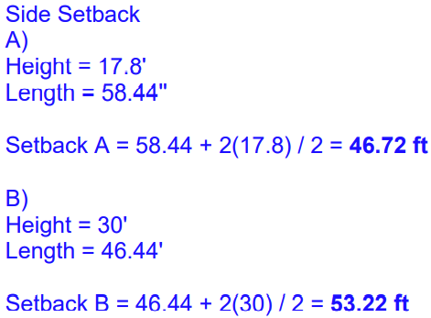
Algebraic Formula – aka “Calculated Setback”
Applicant to dimension setback from PL to Line A:
If greater than 46.72’ – complies.
If greater than 53.22’ to Line B – complies.
S T R E E T
*Note: these lines are cross-sections of the home, and not just exterior walls

Slide 25
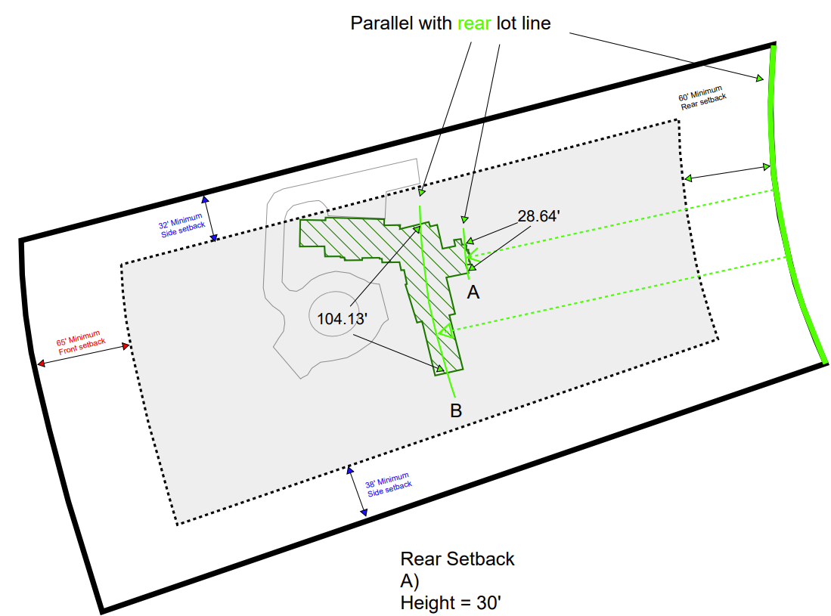
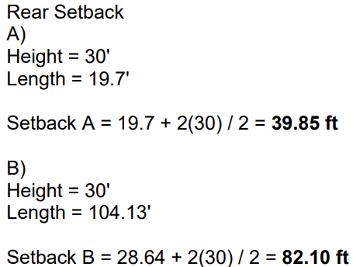
Algebraic Formula – aka “Calculated Setback”
If greater than 39.85’ – complies.
Applicant to dimension setback from PL to Line A:
If greater than 82.10’ – complies.
S T R E E T
*Note: these lines are cross-sections of the home, and not just exterior walls

Slide 26
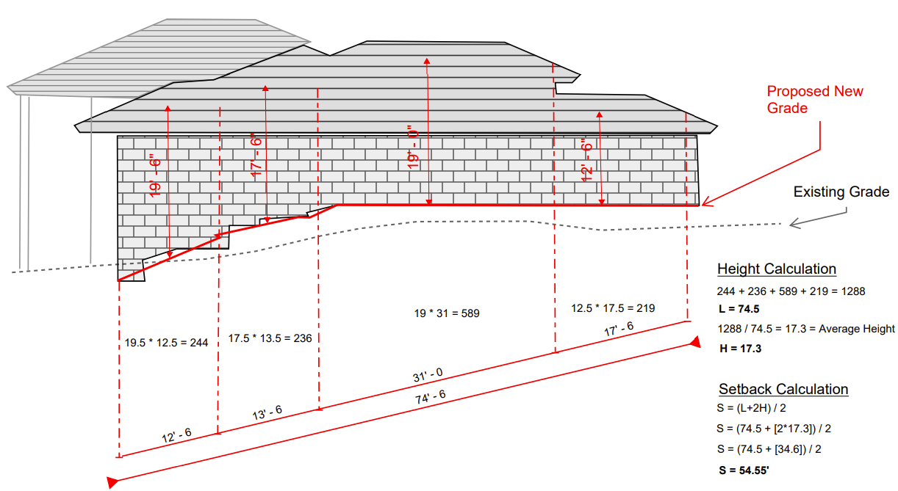
Algebraic Formula – aka “Calculated Setback”
To determine bldg. height for setback purposes, measurements can be made from the proposed grade (or existing grade if there is no change in grade).
Note: the difference in method when calculating the maximum building height (use of average grade).

Slide 27

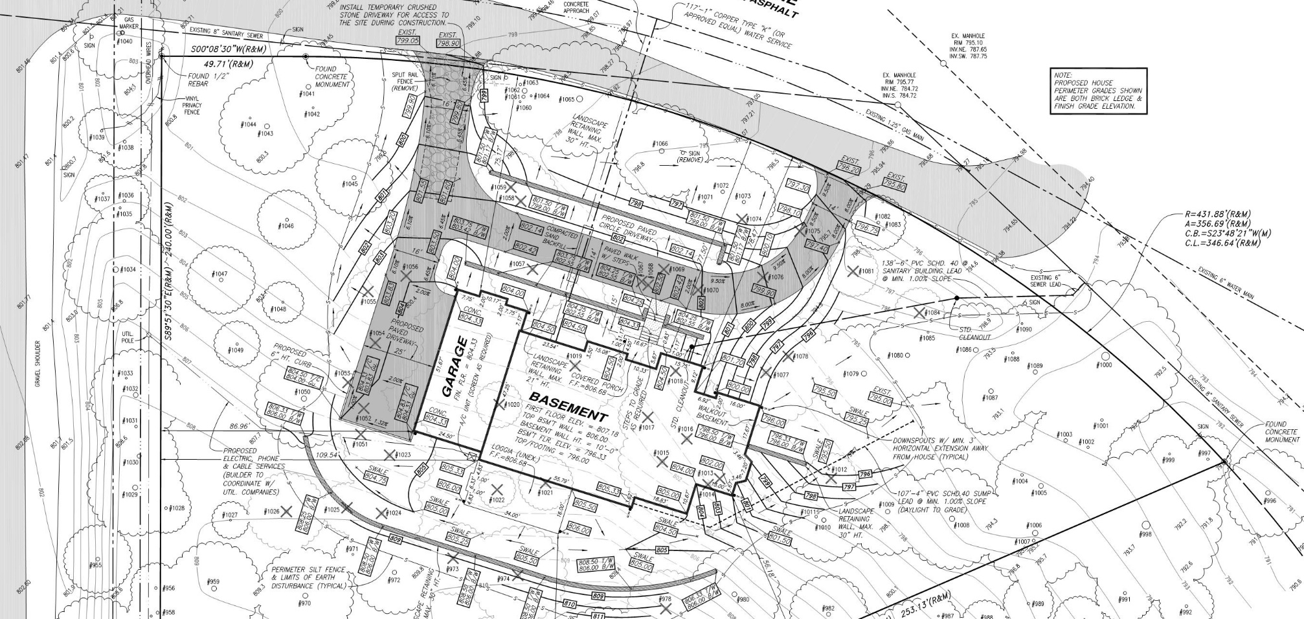

Grading Plan Review Process - Overview
Detailed grading plans are required for almost all projects that involve a design professional.
The Grading Ordinance Checklist fully details the plan requirements.
Notes:
The Grading Ordinance (Chapter 7.5) requires that full grading plans are required for all:
New Single-Family construction, or modifications of an existing structure of more than one (1) room or 600 square feet.
Multiple family, commercial or site condominiums.
Road construction on private property.
Grading or filling, i.e. alteration of existing topography.
Clearing or grubbing.
Construction of landscape berms.
Any development or site construction requiring site plan approval from the Planning Commission or as directed by the City Manager, Building Official, or Engineer.

Slide 28
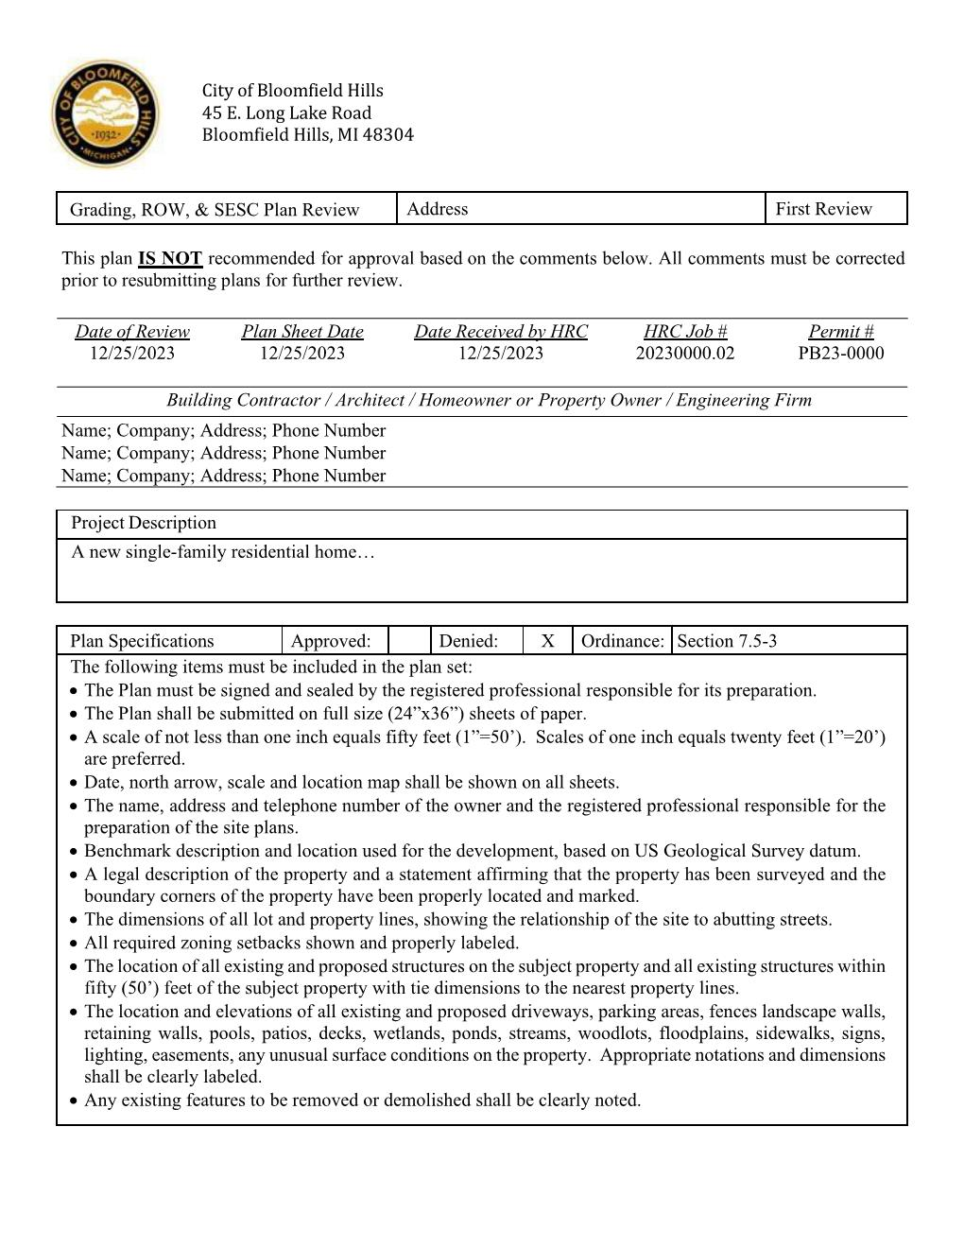
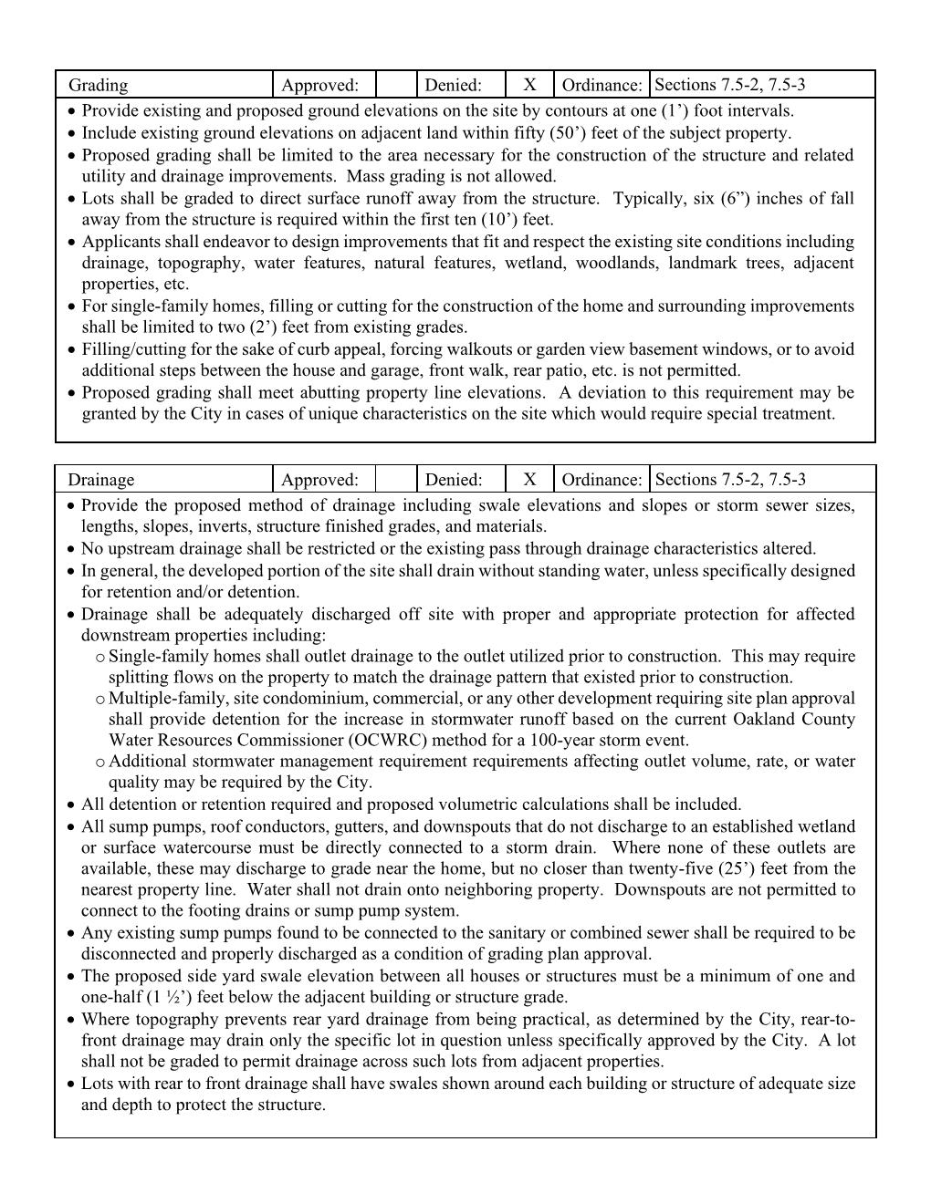
Grading Plan Review Process - Overview
DO NOT FORGET THE BASICS

Slide 29
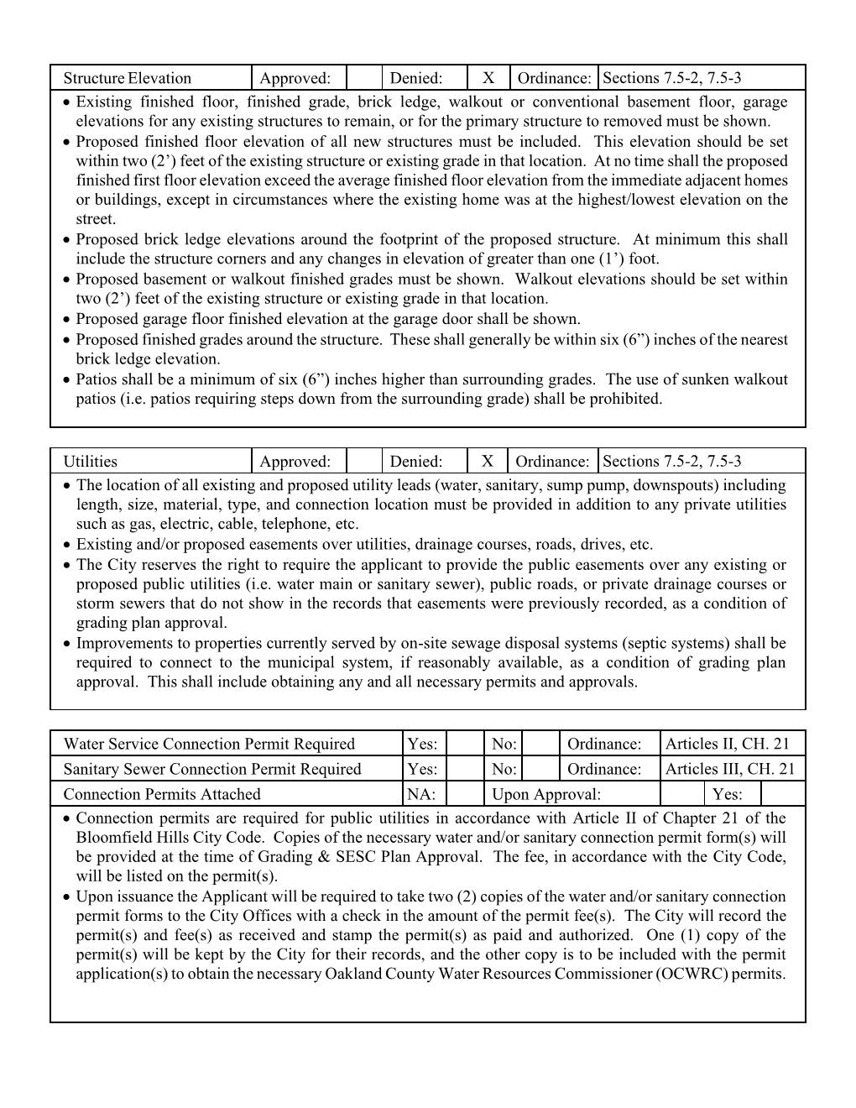
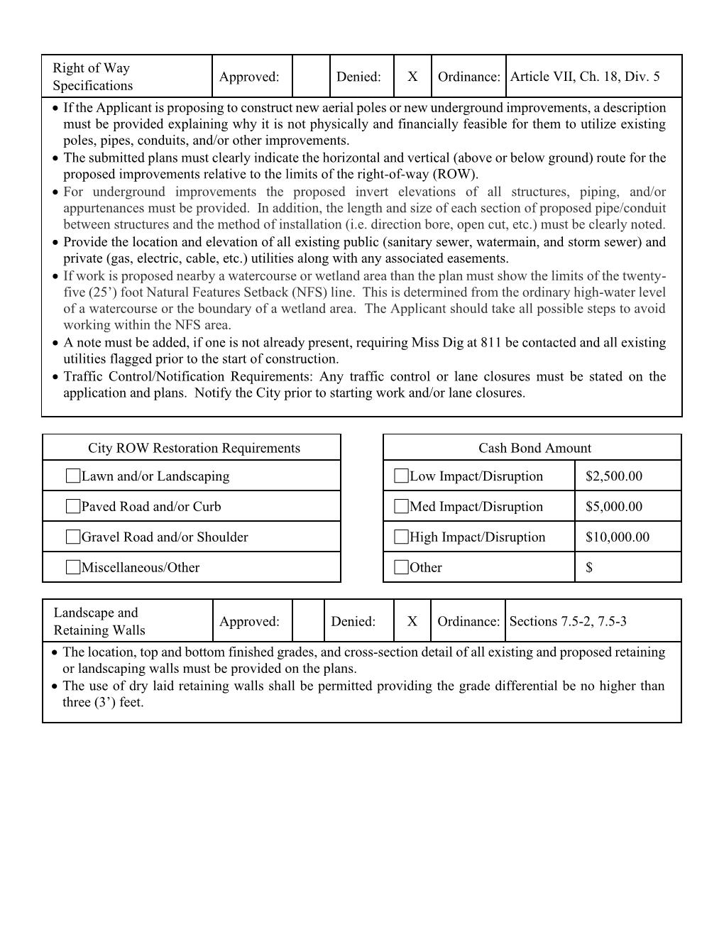
Grading Plan Review Process - Overview
NOT ALL PROJECTS REQUIRE ROW PERMITS

Slide 30
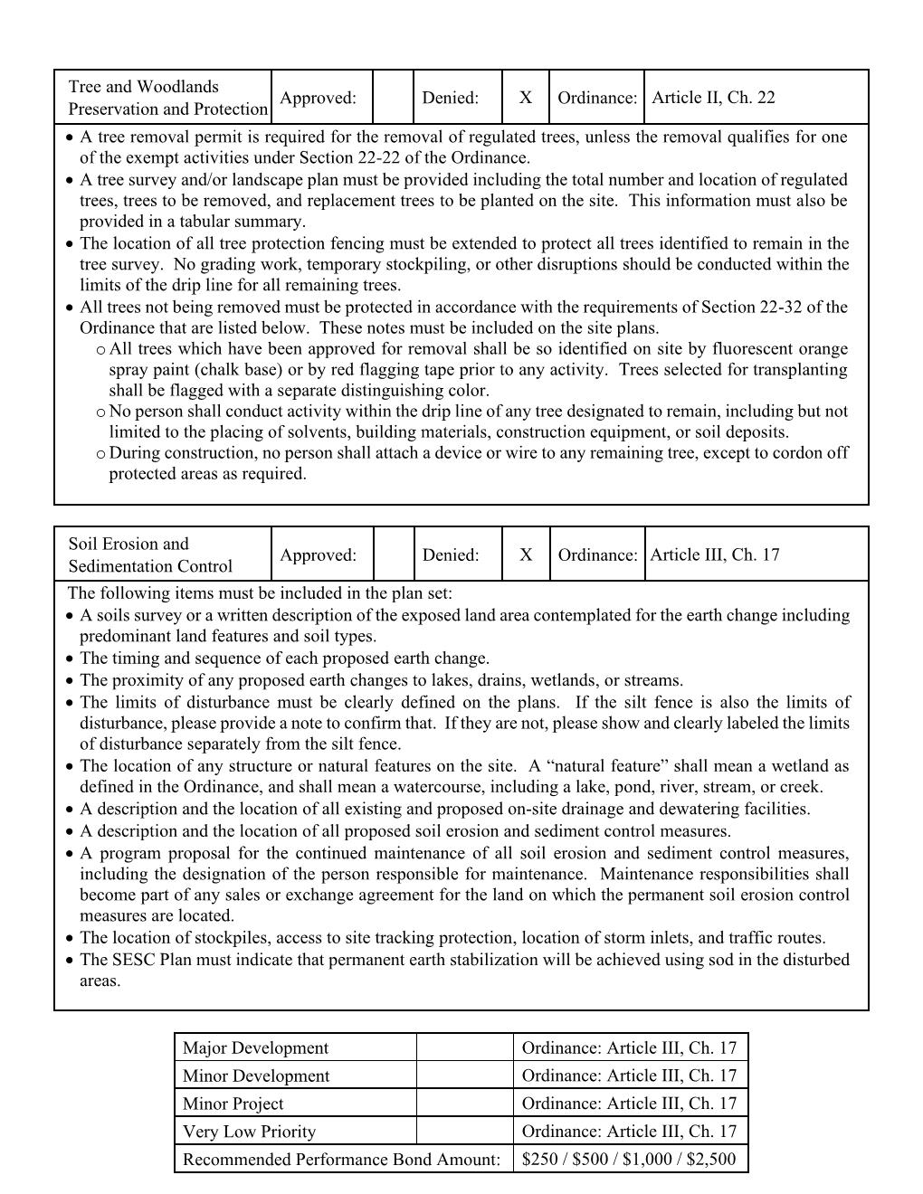
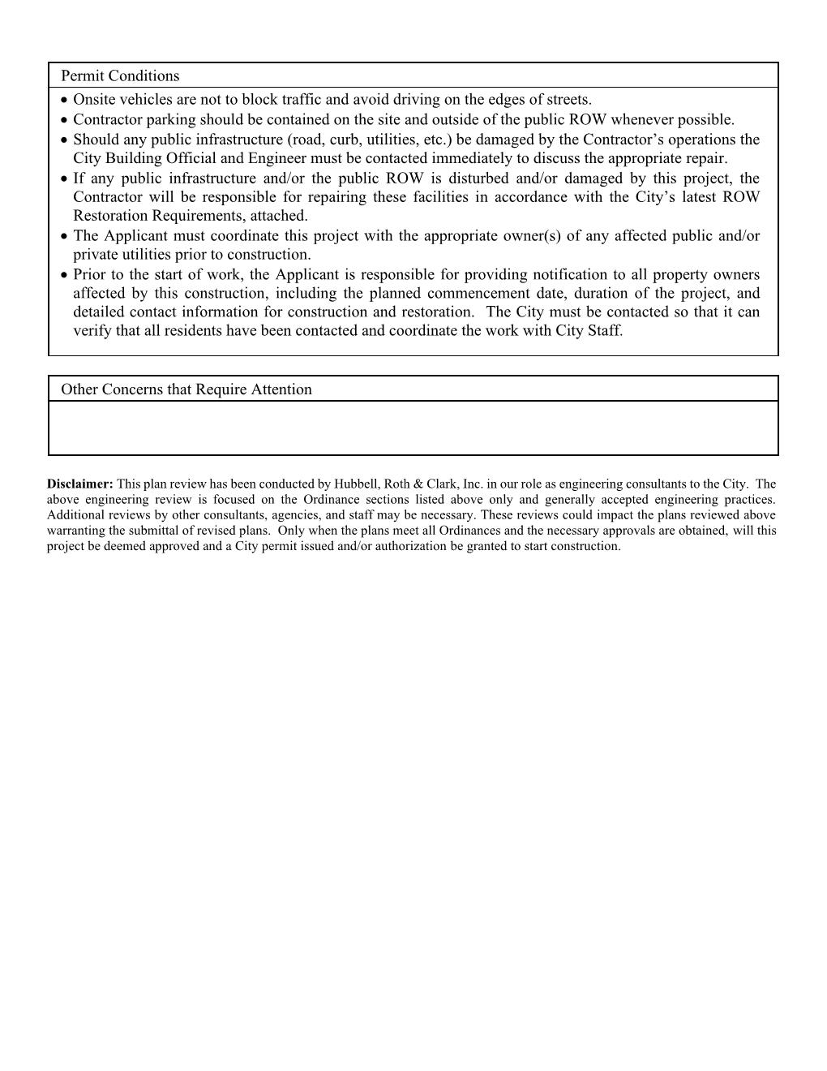
Grading Plan Review Process - Overview
ALL PROJECTS REQUIRE SESC PERMITS AND MEASURES

Slide 31
Grading Plan Review Process - Overview
The Grading Ordinance requires design improvements that fit and respect the existing site conditions (i.e. topography).
The main components of the site plan consist of the following:
Grading plans are through final landscaping
Existing Topography
Proposed Grading
Building Elevations
Public & Private Utilities, including Service Leads
Drainage Pattern & Systems
Soil Erosion & Sedimentation Control
Notes:
Key Plan Requirements:
Mass grading a site will generally not be permitted.
Properly permitted irrigation wells are permissible; however, domestic water supply wells are prohibited.
New construction and re-builds require water and sanitary sewer capital connection permits.
The minimum water service lead size is 1.5”; HDPE and Copper are permitted.
The minimum sanitary service lead size is 4”

Slide 32
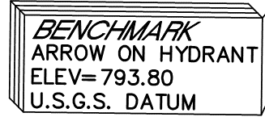
Grading Plan Review – Common Issues
Items most commonly missing from plans:
Proposed Grading Contours
Public & Private Utility Leads
Property Description/Benchmark
Retaining Wall Sections
SESC Notes
Most common non-compliance plan items:
Fills or cuts in excess of two (2’) feet
Forced walkouts
Retaining wall in excess of three (3’) feet
Mass grading (including impacts to trees)

Slide 33
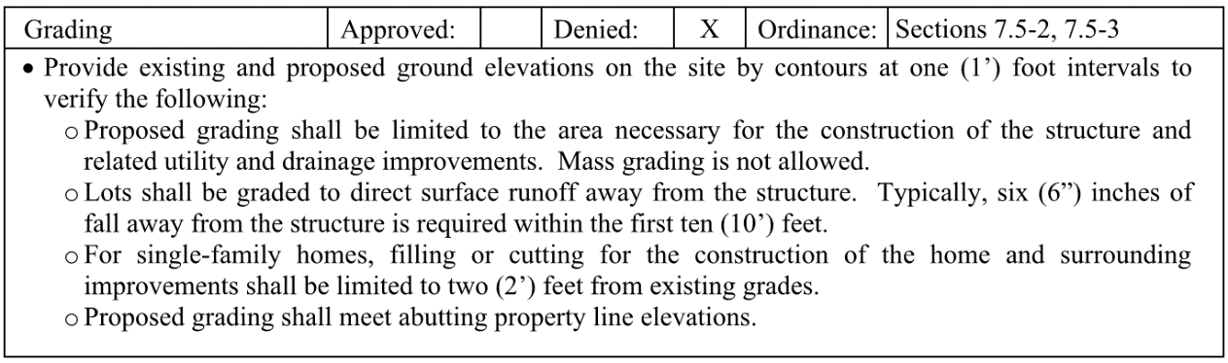
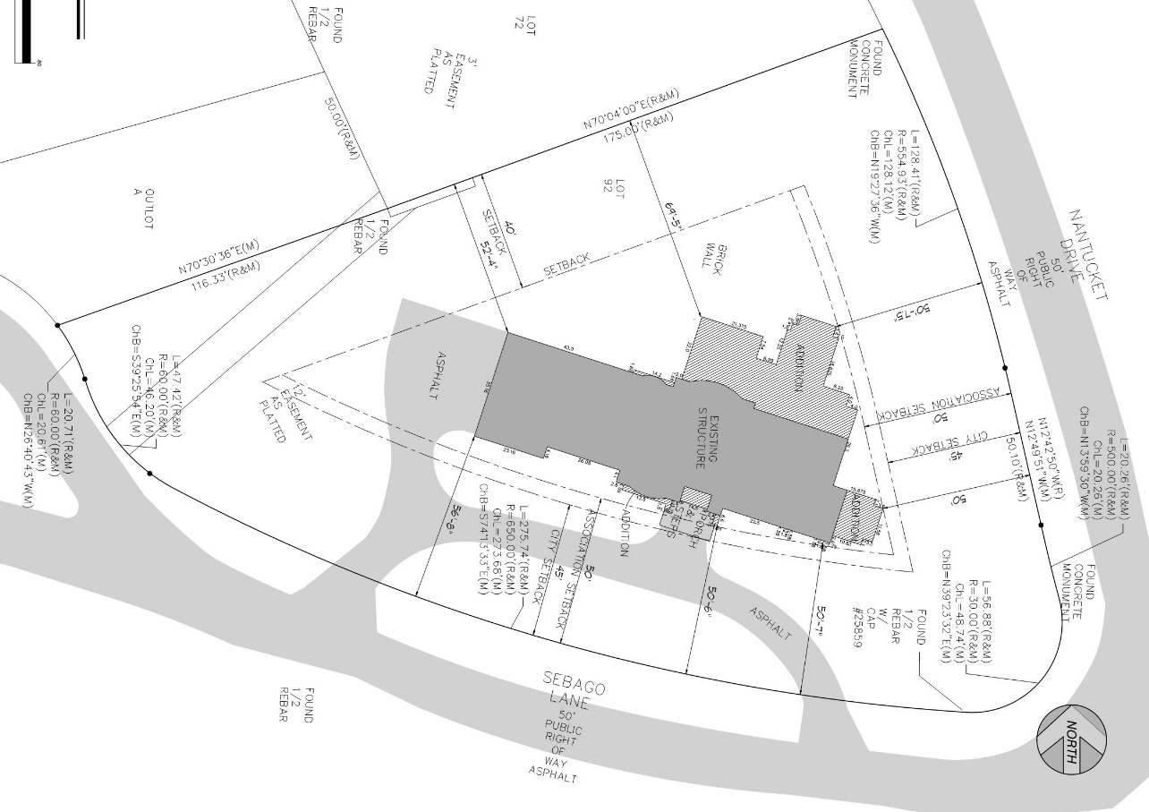
Review Process – Common Issues
Notes:
Common Issue – Providing topographic information
Buildings don’t float. There has to be a topographical context for every project.

Slide 34
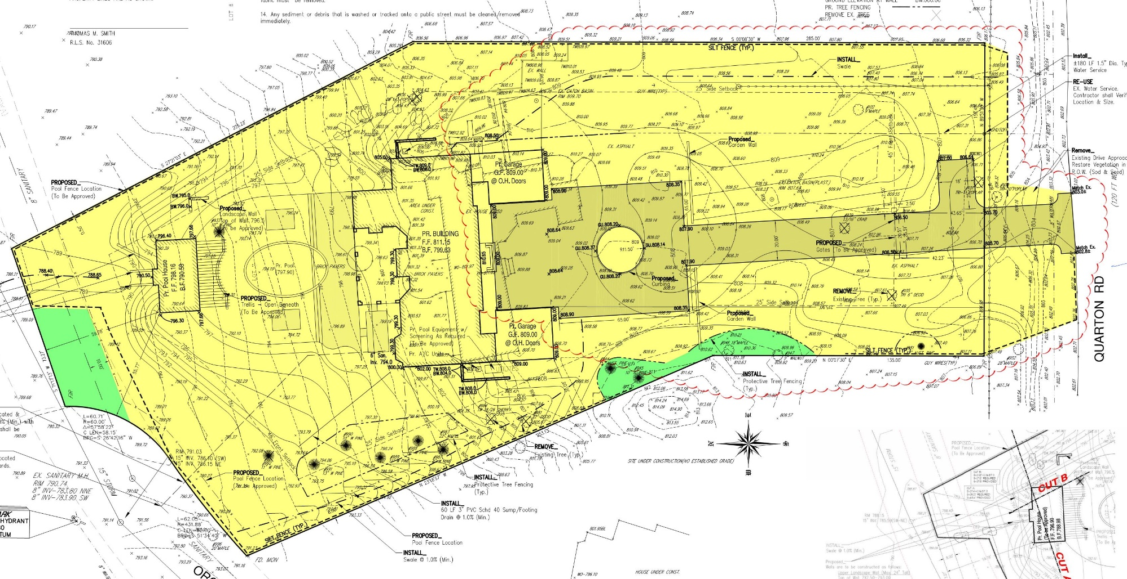
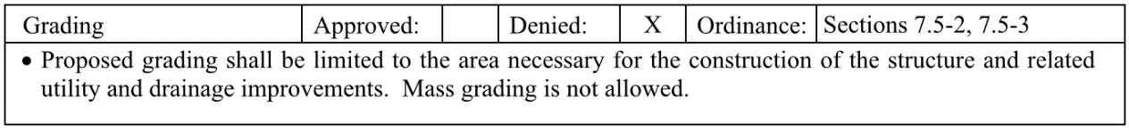
Review Process – Common Issues
Notes:
Semi-Common Issue – Mass grading
Don’t push the grading scope beyond where it needs to be for the improvements and drainage. Expanding the area of impact for landscaping is not permitted. Neither is removing all existing vegetation and trees. Communicate to the builder that there is a mass grading prohibition and that the site work should be carried out as close as possible to the plan.

Slide 35
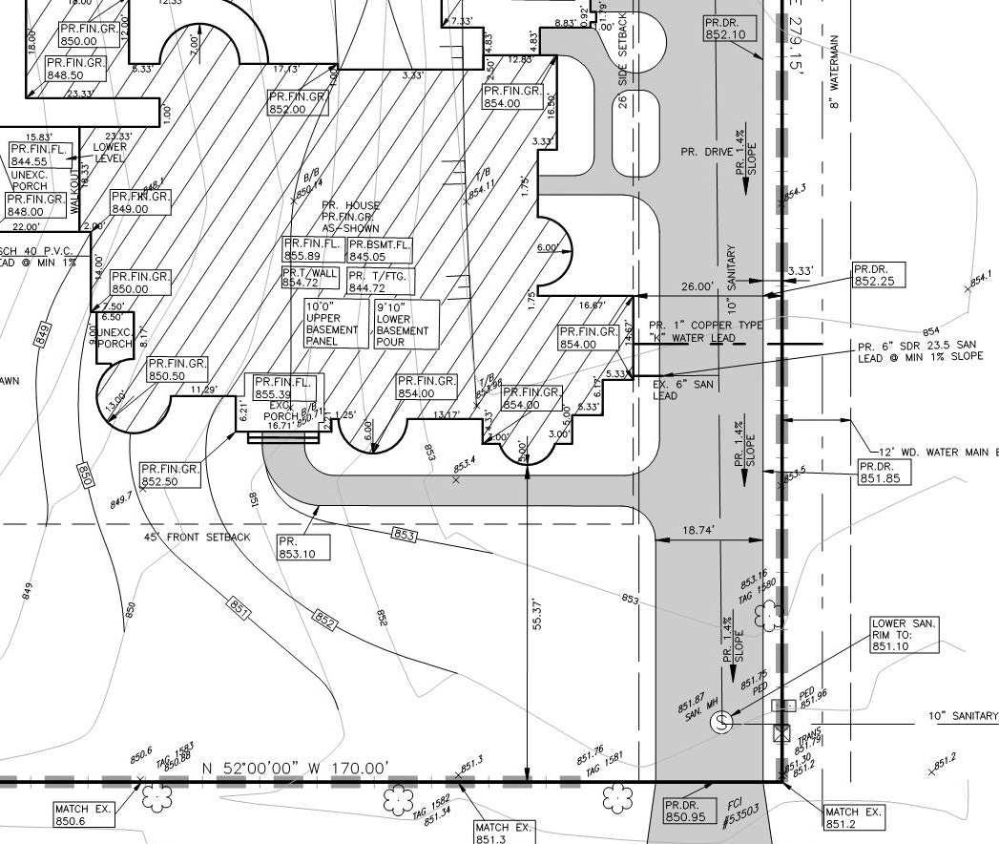
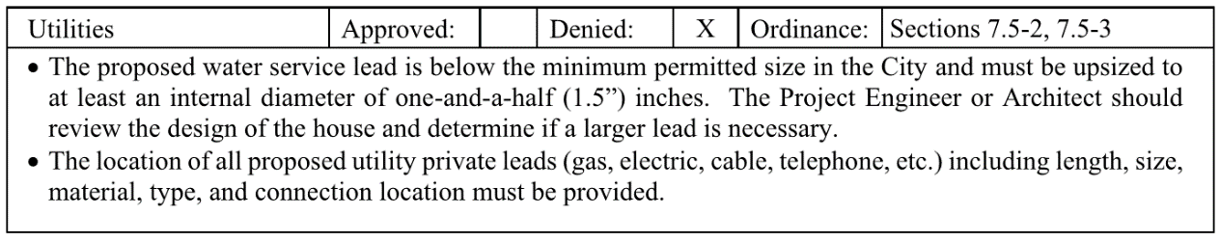
Review Process – Common Issues
Notes:
Common Issue – Minimum public service lead sizes
Be as thorough as possible with utilities. Remember that these residences need larger service leads to have adequate water pressure.

Slide 36
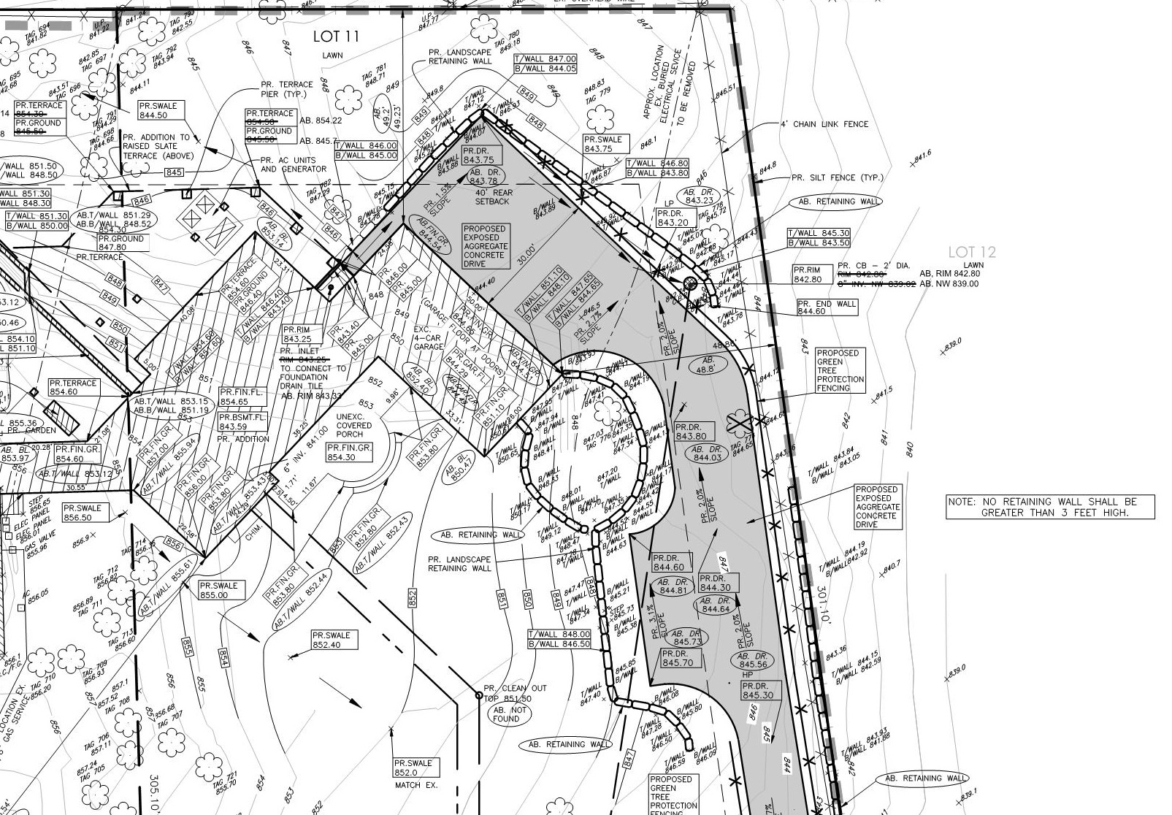
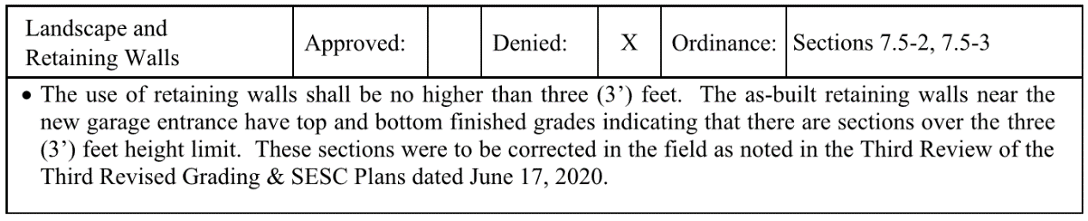
Review Process – Common Issues
Notes:
Common Issue – Retaining wall heights
Retaining walls need to have a sufficient amount of spot grades provided, and all spot grades must be compliant with the Ordinance. Review the grades to ensure they are compliant.

Slide 37
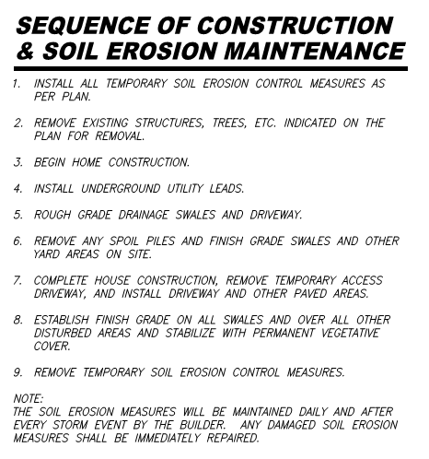
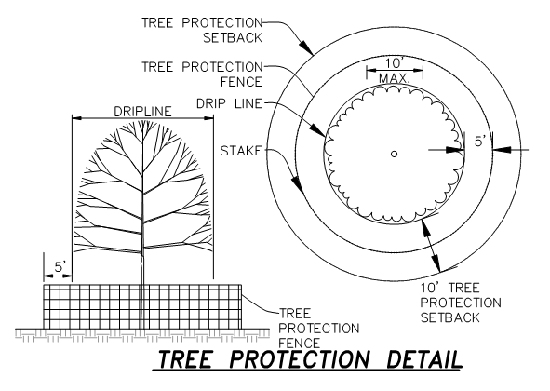
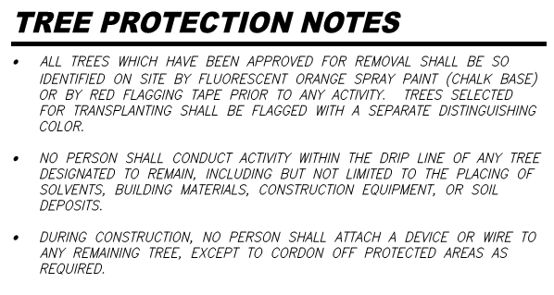
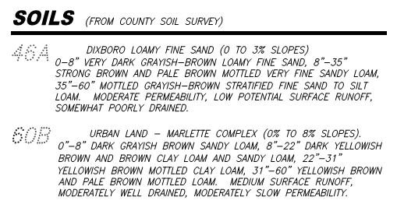
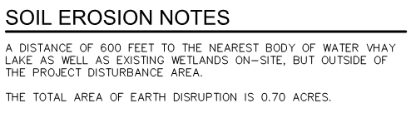
Review Process – Common Issues
Notes:
Common Issue – SESC & Tree Protection notes are forgotten
Remember these important notes! SESC and Tree Protection need many of these for approval.

Slide 38
Grading Plan Review – Approval
The Grading Ordinance and Zoning Ordinance are interrelated as far as building heights, grading, and setbacks are concerned.
Any revision to one, may impact the other.
Landscape open space and natural features setbacks can also be impacted.
A building permit will not be released until the plans meet the approval of all departments.
Road preservation bonds may be required depending on potential impacts to roads and ensure restoration to City specifications
Notes:
The City reserves the right to require the applicant to provide public easements over any existing or proposed utilities, public roads, or private drainage courses or storm sewers as a condition of grading plan approval.

Slide 39
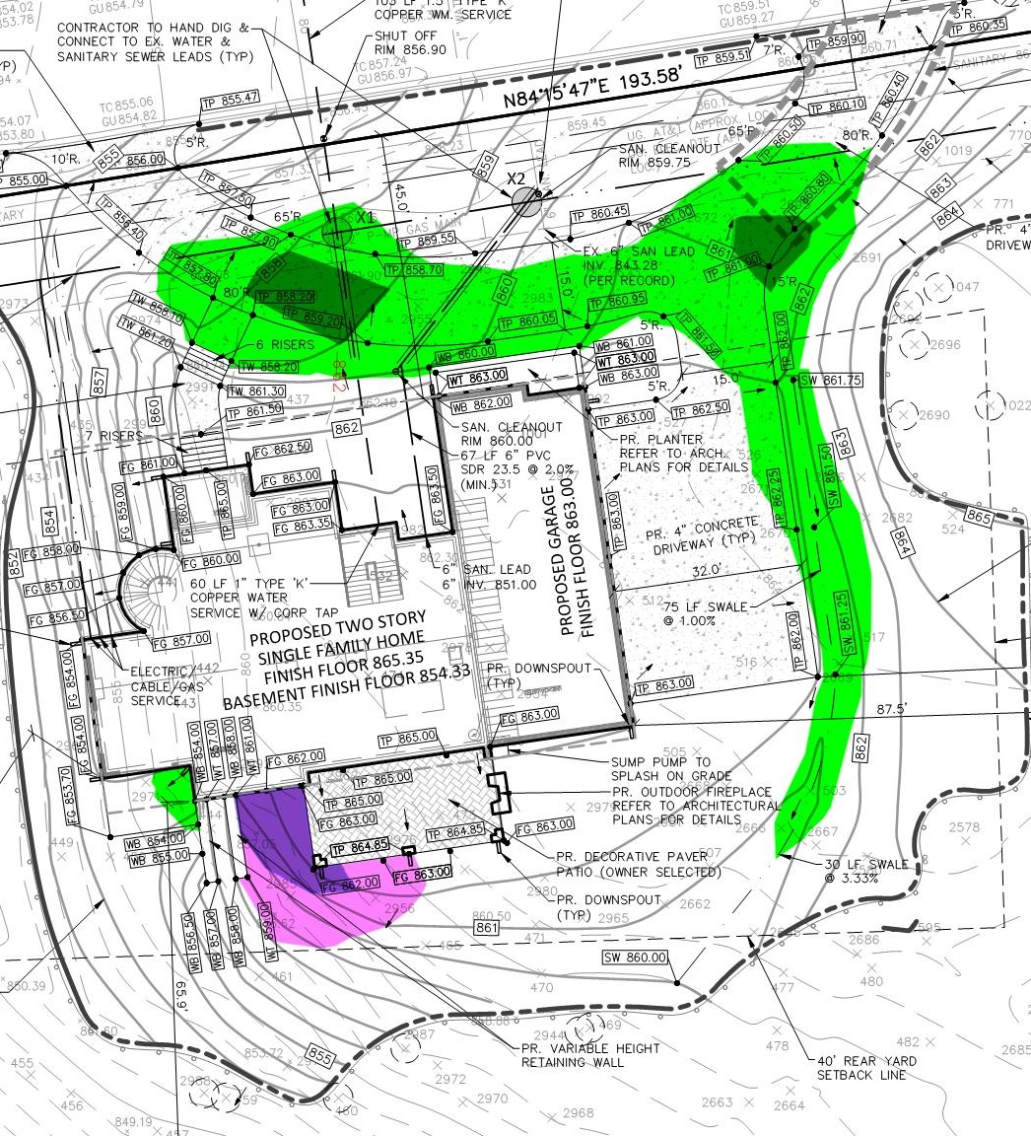
Grading Plan Review – Grading Exhibit
Notes:
Projects that are seeking a grading variance must prepare a grading exhibit to clearly define their request
All exhibits should closely follow the example.
Projects that require grading variances are the most at risk for changes during construction, causing a cascading series of issues. Staking should be performed to guide the contractor in the construction of grading variance projects to avoid return trips to the Planning Commission.
Grading exhibits should use similar colors for fill and cut magnitudes but clearly differentiate the cut from the fill color scale.

Slide 40
Tips for Shortening Plan Review Process
Schedule a pre-application meeting through the City
Always submit directly to the City, not our office
Review the submittal checklist and re-check plans prior to submission
Address all comments on the review letter when resubmitting
Identify changes on the revised plans when resubmitting
Include response letters identifying how review comments were addressed
Resubmit complete plan sets, not just revised sheets

Slide 41
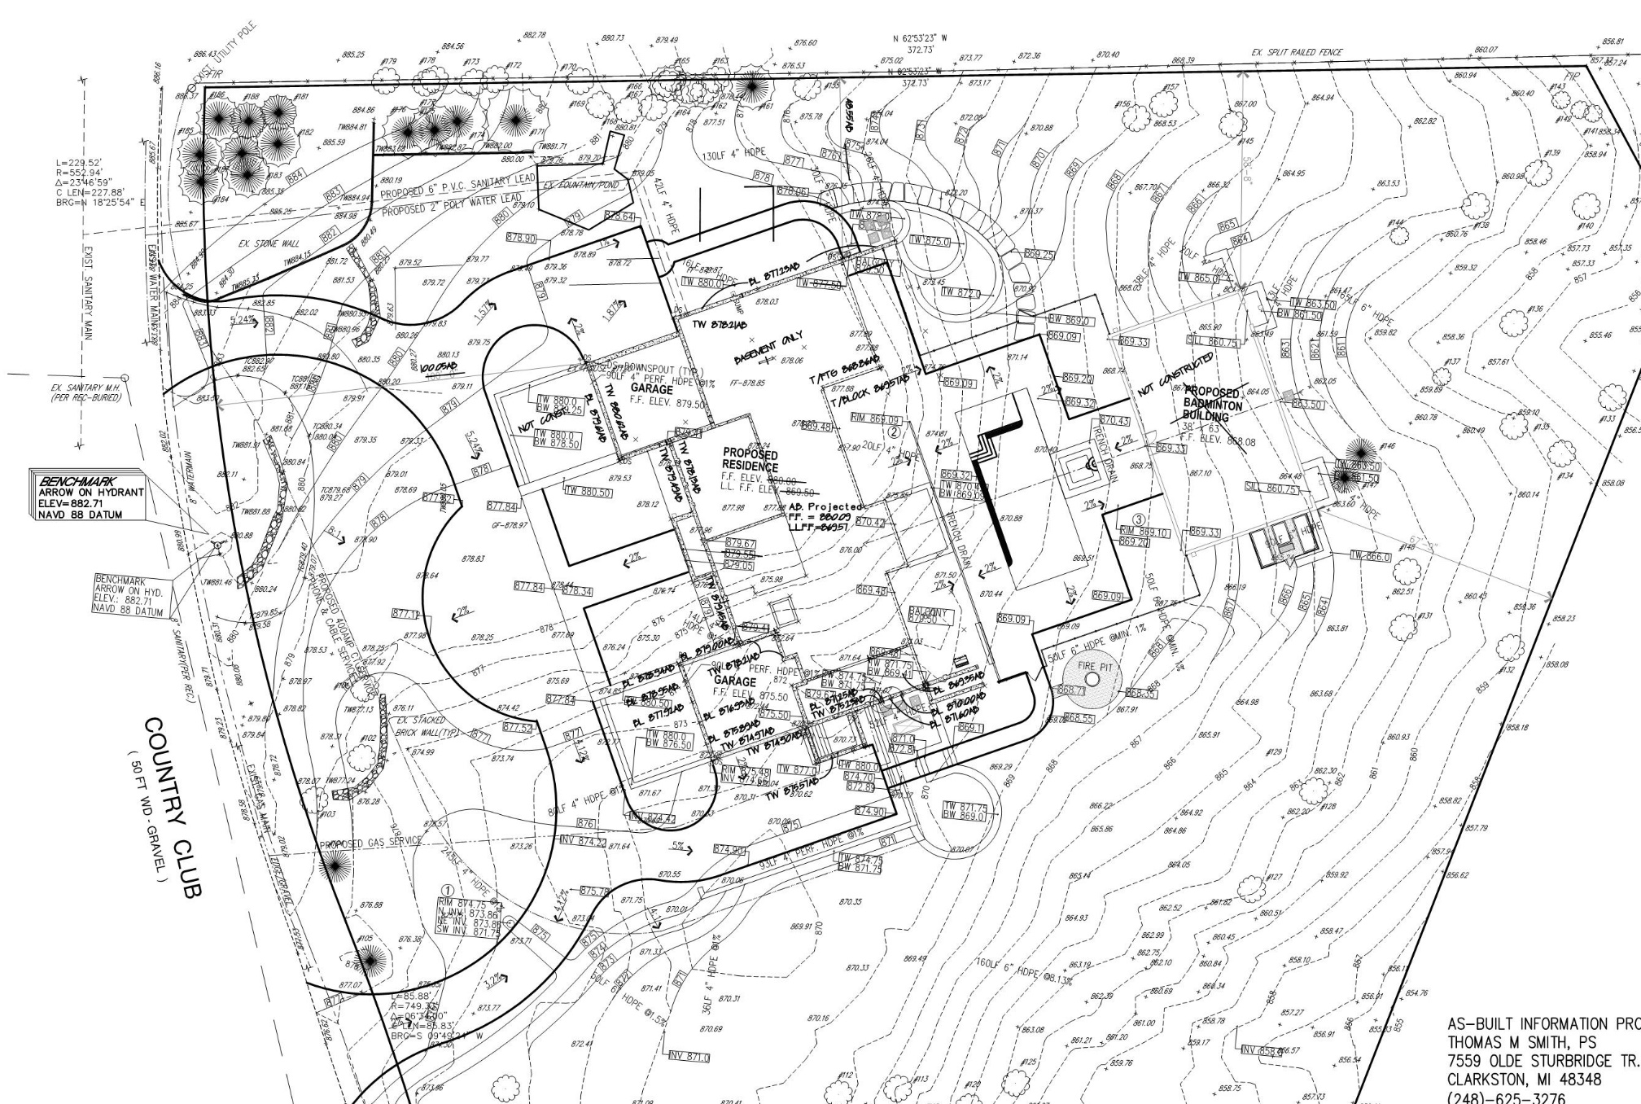
Foundation Certification Plan Requirements
Notes:
After foundation construction & prior to backfill
Plan must show:
Surveyed grades of the foundation walls
As-Built finished floor elevation based on the field shots and planned floor system
As-built tie-down dimension showing the building is located per the approved plan
Rough framing of the structure can not begin until the certification has been approved.

Slide 42
Construction Process – Common Issues
During construction, issues arise that are discovered by City staff or neighbors of the project site.
Issues that should be avoided are:
Deviations from the approved plans
New walls, landscaping, or hardscaping
Adding un-approved structures, fencing, walls, or accessory structures that require PC Approval
Grading beyond the limits on the approved plans
Run-off from the construction site draining onto neighboring properties
Missing or failed soil erosion control measures
Parking/damaging the edge of roads

Slide 43
Construction Process Plan Changes
Discuss any potential field change with the City Building Official prior to starting to build it!
Submit revised plans for review and approval as directed by the Building Official.
Failure to submit revised plans can result in significant delays and additional costs during the as-built plan review process.
The removal of violating feature(s) may be required.
Notes:
Key Tips:
Minor changes may be made with field approval of the Building Official and must be noted on the as-built plans.
Document all changes that do not result in revised site plans for easier preparation of as-built plans.
Do not start on the construction of revised features without revised plan approval.
The City should be notified if construction in the field is not proceeding per the approved plans.
Any design changes and plan revisions made after the initial plan is approved that are not submitted to the City are invalid. These unapproved revisions are not a basis for any variance requests.
Failure to construct projects in accordance with the Ordinance will result in Code Enforcement’s involvement in the resolution process and all responsible parties being issues tickets.

Slide 44
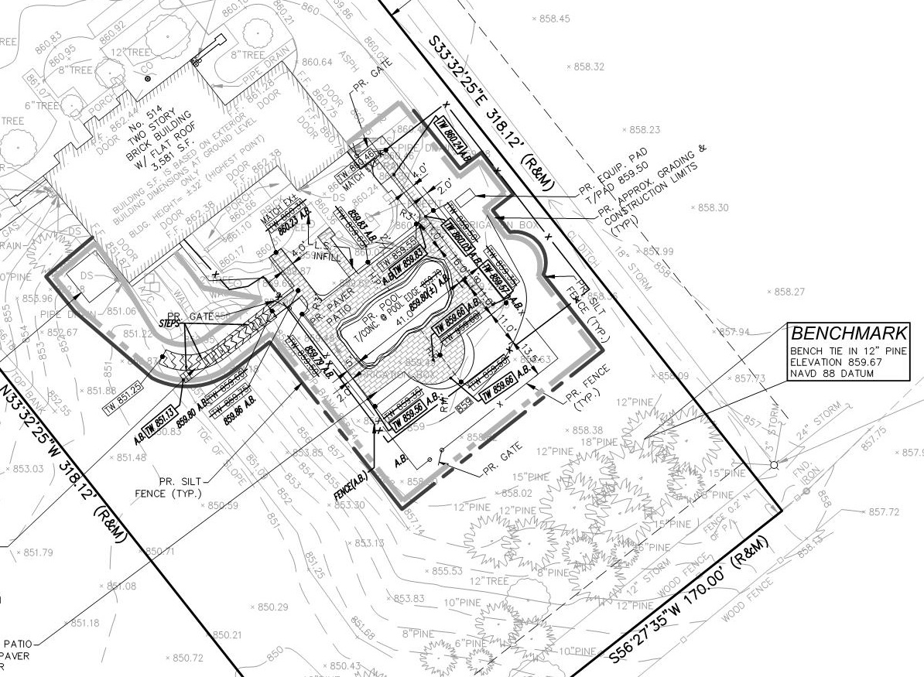
As-Built Grading Plan Requirements
Notes:
As-Built Plans must be approved prior to a Certificate of Occupancy being issued.
As-Built Plan requirements are the same as those for Grading Plans.
Ensure the ROW has been properly restored before submitting As-Built Plans. Inform the Building Official of any damage to public roads and the restoration plan.
The as-built grading plan process can proceed only as quickly as the quality of the as-built plans that were submitted and the level of adherence to the approved grading plans can permit.

Slide 45
Natural Features Setback Requirements
Structures, improvements, and disruptions are prohibited within 25’ of a natural feature. Natural features are:
Any permanent improvements within the 25’ setback requires Planning Commission approval.
The preference for projects that affect natural features is for natural materials and plantings to be used.
Streams
Creeks
Rivers
Lakes
Ponds
Wetlands
Notes:
The Natural Features Setback Ordinance (Chapter 24, Article IV) prohibits structures and some improvements within twenty-five (25’) feet of natural features. Some activities within the natural features setback are exempted from receiving City approval, subject to any disturbed areas being restored with native plantings upon completion of the work.
Exempted Activities
Maintenance of established lawn areas.
Grading and filling necessary in order to conform with express requirements imposed by City.
The connection to a public or private utility that is located in or beyond the natural features setback.
Installation of storm water drains with proper water quality measures, irrigation piping, or other related material.
Temporary encroachment for the construction of permissible structures that will lie outside of the setback.
The removal of dead or diseased shrubs, bushes or trees.
Maintenance of an existing water feature.

Slide 46
Soil Erosion & Sedimentation Control Plan Requirements
The City requires SESC permits to be obtained for all projects requiring grading plans in the City.
Proper SESC measures must be put in place before starting construction. Notify Ashley after measures are installed to schedule the initial inspection.
Sod should be used in place of seed for final stabilization. Permits cannot be closed, and Certificates of Occupancy cannot be issued until the lawn has been fully established.
Notes:
The City administers its own SESC program, no additional permits are required from OCWRC or EGLE for residential projects.
Tree protection measures will be inspected for Ordinance compliance during the regular SESC inspections.
Failure to adhere to SESC or tree protection requirements will result in Stop Work Orders being issued.

Slide 47
Building
My Building Permit is APPROVED, what’s next?
Preconstruction meeting with construction schedule
Any changes to the approved plans after permit is issued must be re-submitted for approval
Permit is valid for 6 months, Plan of Completion and updated construction schedule is required to obtain a permit extension
Preliminary Foundation As-builts
Final As-builts / Certificate of Occupancy

Slide 48
Code Enforcement
Construction Site Management
Construction parking
Work hours
Tree protection
Soil Erosion Fence
Mud Mat
Weeds
Road Bond
18 month – Site Stabilization
Zero Tolerance of working without a permit
Public Safety enforcement of active construction sites

Slide 49
Thank you for joining us!
Our panel is available to answer
any questions.

